Slide 1
Standard User – Check Out / Check In Contracts
February, 2013

Slide 2

Learning Objectives
Upon completion of this course you will be able to:
Check out a contract from ECM.
Edit the contract offline.
Check in the revised contract using the MS Word Language Editor.

Slide 3

Check Out a Contract
An author may wish to work on a contract outside of ECM, for example, while on an airplane.
  Or, you may want to send the contract to another author for updates or changes outside of ECM.
  You can check out the contract and after the changes are made, check in the revised document.
When a document is checked out it can be saved as a MS Word document on your desktop or other folder/location.
From the Language tab, click the Check Out Language icon on the main, blue toolbar.

Slide 4
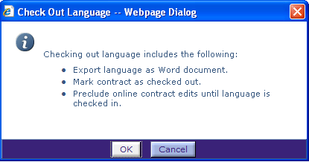
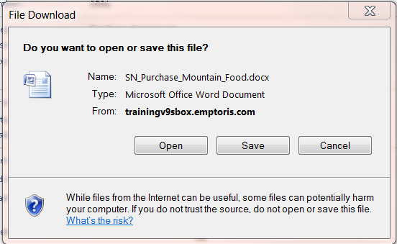
Check Out a Contract, cont.
Note the actions displayed in the information display box.
Click OK to check out the language.
A “Save As” dialog box is displayed.
Click Save.
Note: In some circumstances on
V10, you may not get prompted
for the location at which to save the
file. If this occurs, find the file by
searching for <contract name>.docx.

Slide 5
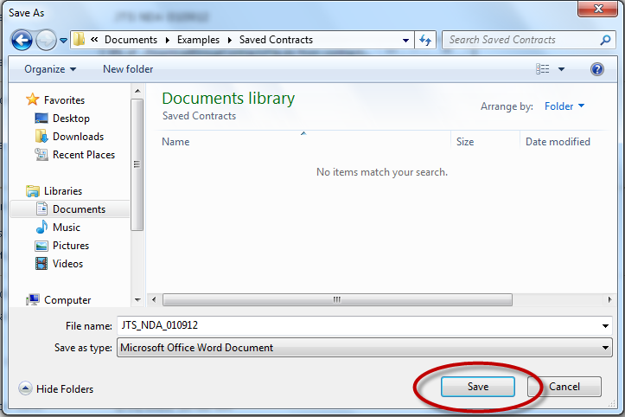
Check Out a Contract, cont.
Notice the file name is automatically assigned the name of your contract in ECM.
Navigate to the folder on your system or desktop.
Click Save to save the contract using the displayed file name.
The contract is closed and you are returned to the Contract Editor Page.

Slide 6
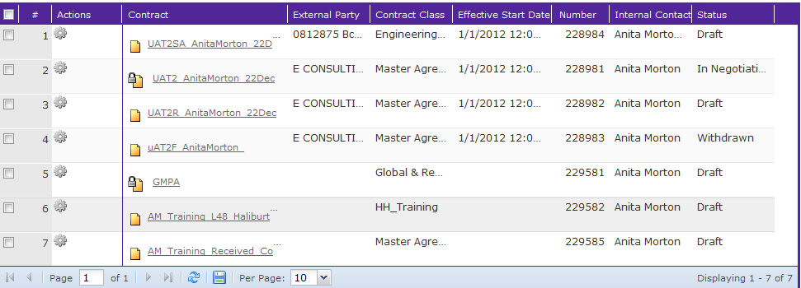

Check Out a Contract, cont.
The contract is now locked and cannot be edited.
The document will remain locked until either the language is checked back in or the check out is ‘cancelled’ by clicking the Cancel Check out icon.

Slide 7
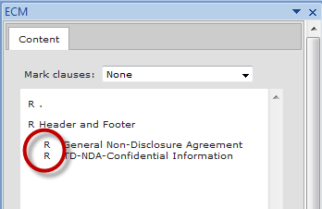
Check Out a Contract, cont.
If you open the document in Edit mode, the clauses are marked as “read only”.

Slide 8
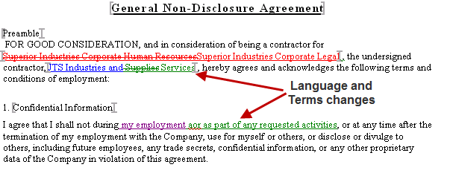
Edit the Contract Offline
Edit the document offline using MS Word.
You can insert text, delete text, or make other formatting changes as needed.
Save your document. It is not necessary to keep the same file name, but this is generally a good thing to do, to avoid confusion.

Slide 9
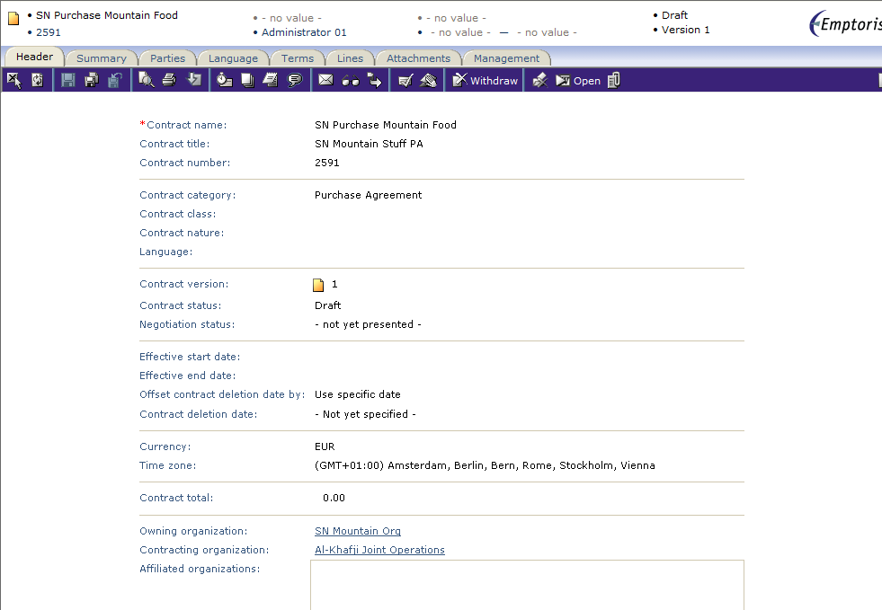
Check in Revised Contract
Open the contract.
  From My Contracts, click the hyperlink to open the contract.
From the Contract Editor page, click the Language tab.
Click the Open icon. The document opens with the MS Word Editor displayed.

Slide 10
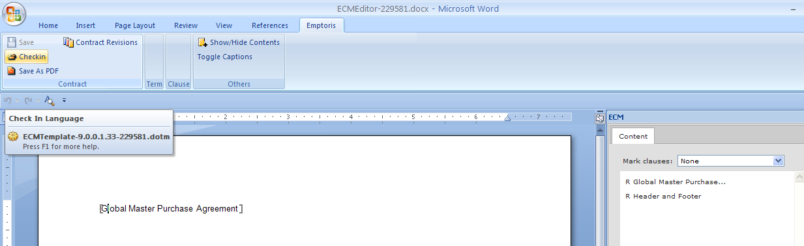
Check in Revised Contract, cont.
Click the Check in button on the Emptoris MS Word Language Editor toolbar.
The Choose File dialog box is displayed.

Slide 11
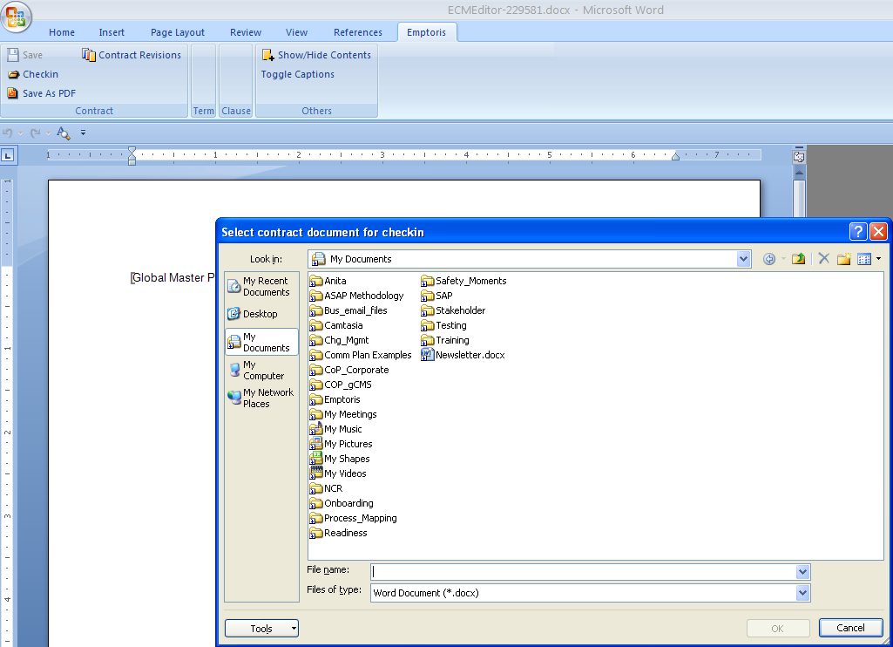
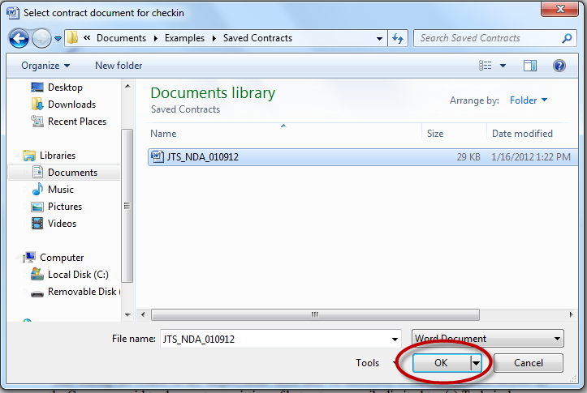
Check in Revised Contract, cont.
Navigate to the folder containing the contract.
Click to highlight the document name.
Click OK to select the highlighted file.

Slide 12
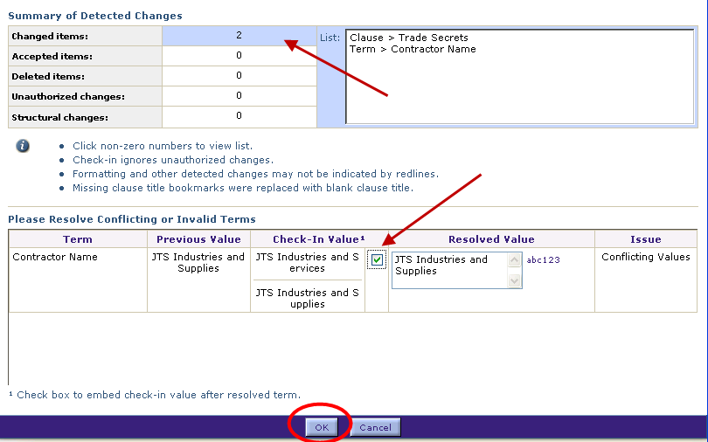
Check in Revised Contract, cont.
The Check In Summary dialog box opens and shows the changes to the contract.
You can click on each type of change to see a list of the clauses where those changes may have been detected.
Each document is digitally stamped; therefore, the system won’t allow you to check in a document other than contract that was checked out. However, a document can be renamed and checked in, because the digital stamp is unaffected.
Any unauthorized changes are indicated and the author is given the opportunity to accept the change by selecting the check box, as shown below.
Click OK to finish checking in the document.

Slide 13
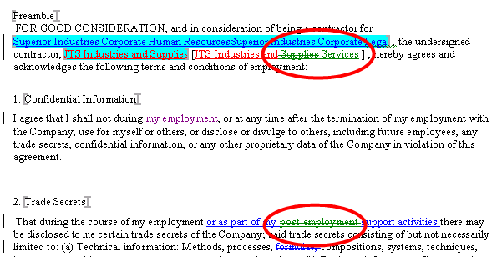
Check in Revised Contract, cont.
The document is updated and the changes are highlighted.
You can make additional changes or accept the new text.
Remember to Save the revised document.
The document is no longer in the ‘locked’ status.

Slide 14

Questions?

